Slide 1

RECAP
Topic Already Covered:
Computer Vision Introduction
Convolution Operation
Edge Detection
Padding
Stride
AI4LE Week 5. Session 1

Slide 2
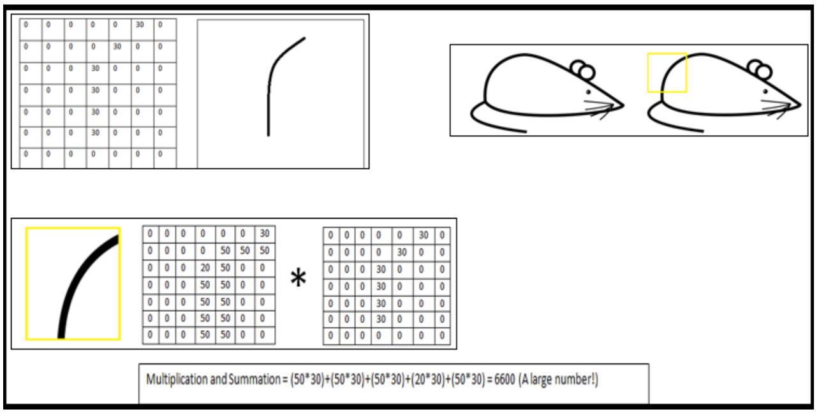

Slide 3
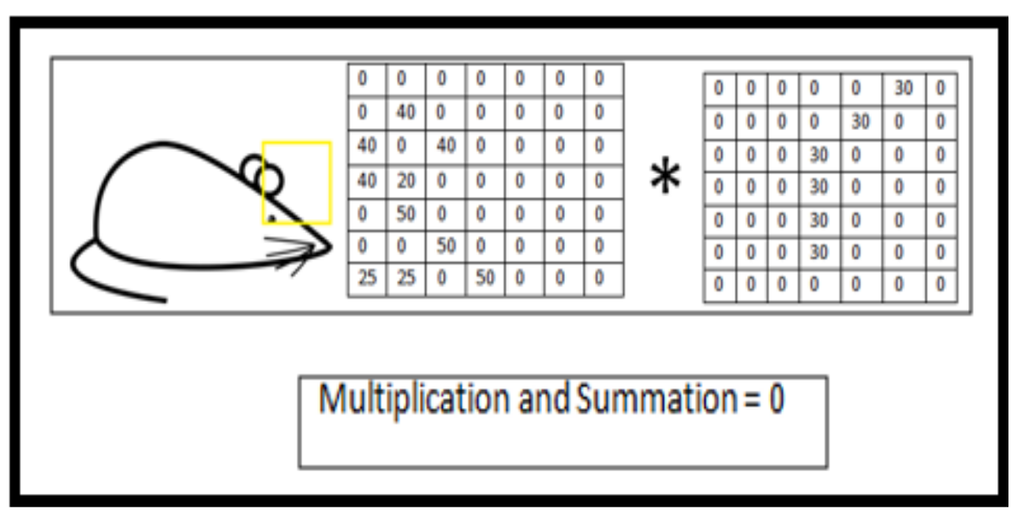

Slide 4
Today we will see..
Receptive Field
Pooling
Dropout
Batch Normalisation
Augmentation
AI4LE Week 5. Session 1

Slide 5
Receptive Field
The receptive field is defined as the region in the input space that a particular CNN’s feature is looking at (i.e. be affected by).
A receptive field of a feature can be described by its center location and its size.

Slide 6
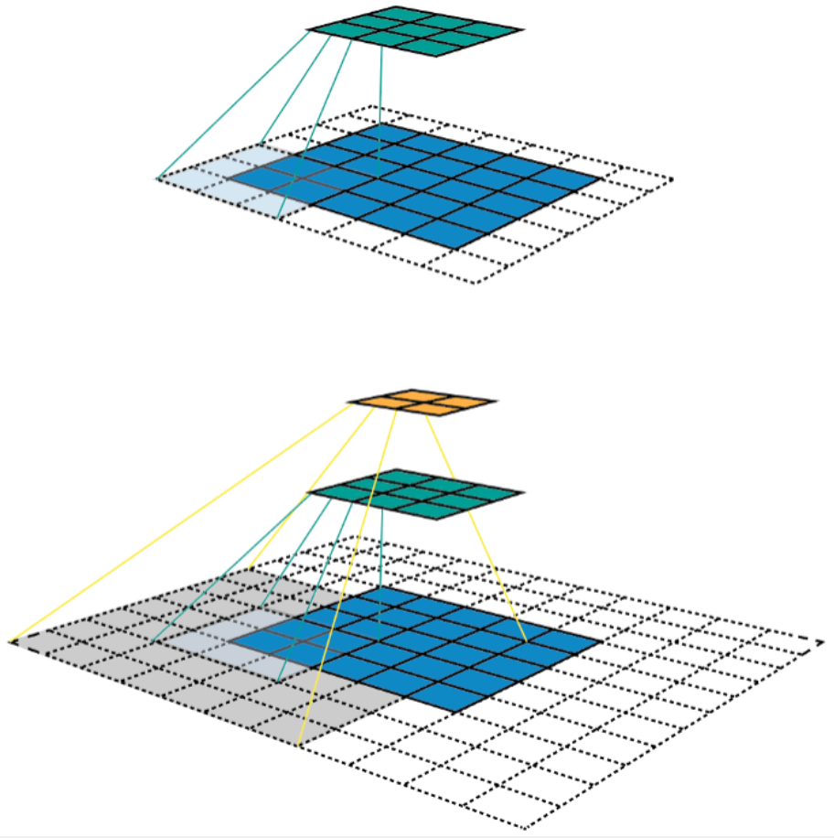
Visualization of Receptive field

Slide 7
Number of layers to accommodate whole of the input
2*num_of_layers + 1 >= r
2 * x + 1 >= 5
=> x >= 2 so, 3 Layers!!
What about for a 1000-by-1000 image??
Ref: https://www.youtube.com/watch?v=70A3uYfM1qA&ab_channel=AppliedAICourse

Slide 8
Problem of Diminishing Gradients
The gradients to be learnt at a later stage in the layer hierarchy might be very very different from the gradients to be learnt at an early stage.
We tend to lose gradients which are smaller - this is the problem of diminishing gradients
How to solve? - Reduce the number of layers?
Ref: https://www.youtube.com/watch?v=KKmCnwGzSv8&ab_channel=Serrano.Academy

Slide 9
How to reduce the number of layers?
Pooling! - One solution..
WHAT EXACTLY IS REDUCED? - Size of features!!!

Slide 10
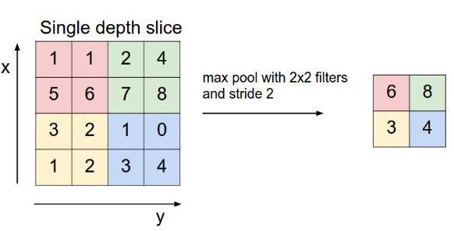
Pooling techniques
Max pooling where we take largest of the pixel values of a segment.
Ref: https://cs231n.github.io/convolutional-networks/#pool
AI4LE Week 5. Session 1

Slide 11
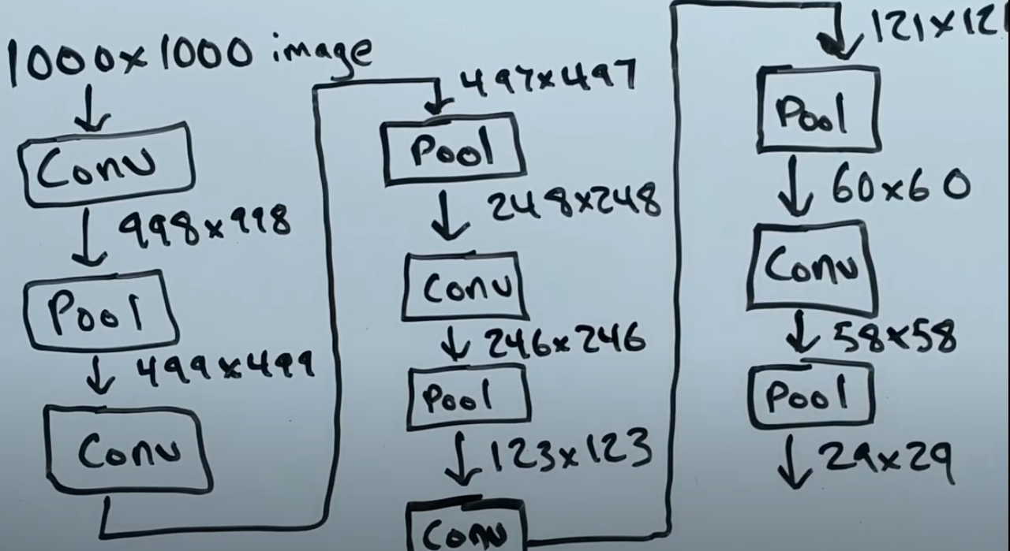
Reductions in a 1000-by-1000 image

Slide 12
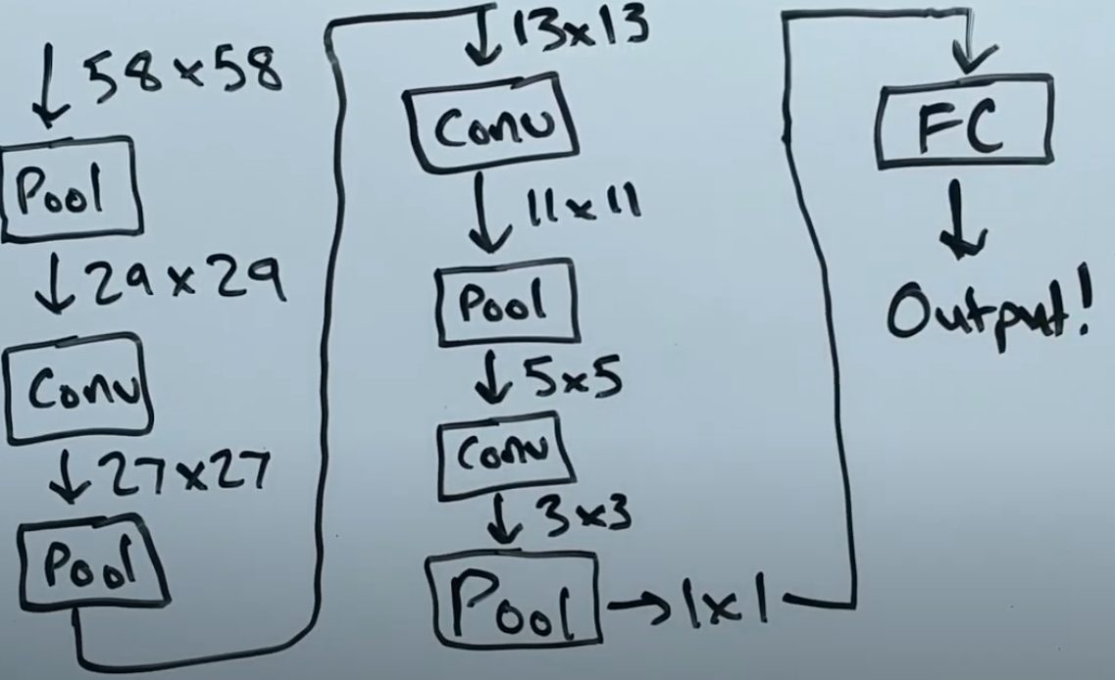
Reductions in a 1000-by-1000 image
Ref: https://www.youtube.com/watch?v=70A3uYfM1qA&ab_channel=AppliedAICourse

Slide 13
New number of layers?
Instead of 500 CONV layers, we now have:
8 CONV layers,
8 Pooling layers,
1 FC layer!!
Total = 17 layers!

Slide 14
Pooling
Pooling is nothing other than down sampling of an image.
The most common pooling layer filter is of size 2x2, which discards three fourth of the activations.
Role of pooling layer is to reduce the resolution of the feature map but retaining features of the map required for classification through translational and rotational invariants.
In addition to spatial invariance robustness, pooling will reduce the computation cost by a great deal - no learnable parameters!
AI4LE Week 5. Session 1

Slide 15
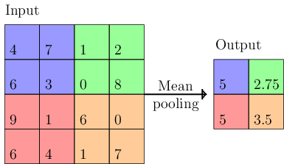
Pooling techniques
Mean pooling where we take largest of the pixel values of a segment
AI4LE Week 5. Session 1

Slide 16
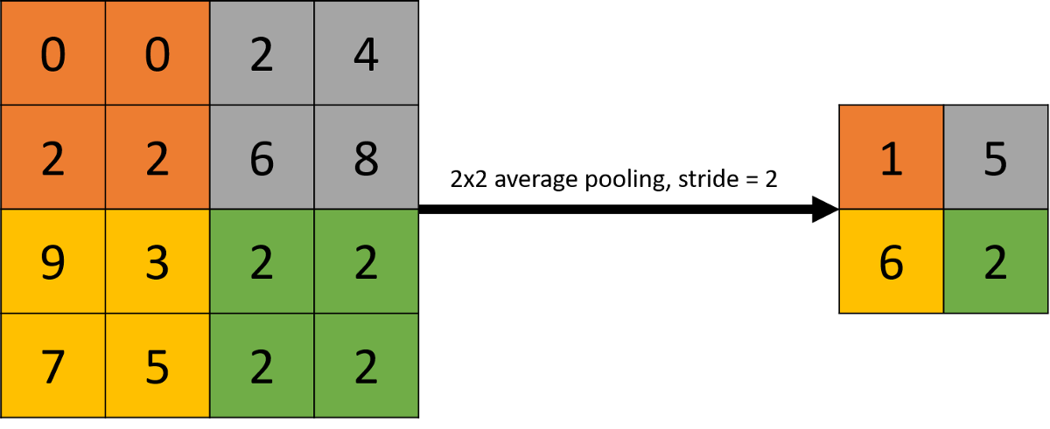
Pooling techniques
Avg pooling where we take largest of the pixel values of a segment.
AI4LE Week 5. Session 1

Slide 17
Other pooling
- Min pooling
- wavelet pooling
- tree pooling
- max-avg pooling
- spatial pyramid pooling
AI4LE Week 5. Session 1

Slide 18
Dropout
Deep learning neural networks are likely to quickly overfit a training dataset with few examples.
AI4LE Week 5. Session 1

Slide 19
Dropout
A single model can be used to simulate having a large number of different network architectures by randomly dropping out nodes during training.
This is called dropout and offers a very computationally cheap and remarkably effective regularization method to reduce overfitting and improve generalization error in deep neural networks of all kinds
AI4LE Week 5. Session 1

Slide 20
Dropout
Dropout is a regularization method that approximates training a large number of neural networks with different architectures in parallel.
AI4LE Week 5. Session 1

Slide 21
Dropout
During training, some number of layer outputs are randomly ignored or “dropped out.”
This has the effect of making the layer look-like and be treated-like a layer with a different number of nodes and connectivity to the prior layer.
In effect, each update to a layer during training is performed with a different “view” of the configured layer.
AI4LE Week 5. Session 1

Slide 22
Dropout
Dropout has the effect of making the training process noisy, forcing nodes within a layer to probabilistically take on more or less responsibility for the inputs.
This conceptualization suggests that perhaps dropout breaks-up situations where network layers co-adapt to correct mistakes from prior layers, in turn making the model more robust.
AI4LE Week 5. Session 1

Slide 23
How to Dropout
Dropout is implemented per-layer in a neural network.
It can be used with most types of layers, such as dense fully connected layers, convolutional layers, and recurrent layers such as the long short-term memory network layer.
Dropout may be implemented on any or all hidden layers in the network as well as the visible or input layer.
It is not used on the output layer.
AI4LE Week 5. Session 1

Slide 24
Dropout
Dropout is not used after training when making a prediction with the fit network.
The weights of the network will be larger than normal because of dropout.
Therefore, before finalizing the network, the weights are first scaled by the chosen dropout rate.
The network can then be used as per normal to make predictions.
AI4LE Week 5. Session 1

Slide 25

Dropout
AI4LE Week 5. Session 1

Slide 26
Batch normalization
Training deep neural networks with tens of layers is challenging as they can be sensitive to the initial random weights and configuration of the learning algorithm.
AI4LE Week 5. Session 1

Slide 27
Batch normalization
Batch normalization is a technique for training very deep neural networks that standardizes the inputs to a layer for each mini-batch.
This has the effect of stabilizing the learning process and dramatically reducing the number of training epochs required to train deep networks.
AI4LE Week 5. Session 1

Slide 28
We know how scaling and normalization of input improves the model
Batch normalization is similar but not on input but at hidden layer
It makes weights at deeper layer more robust to change
Thus helps in generalization of the model
AI4LE Week 5. Session 1

Slide 29
Batch normalization as a regularizer
Each mini batch is scaled by mean/variance computed just on mini batch
It handles data at one batch at a time
Thus it adds some noise to hidden layer and thus gives slight regularization effect
And makes sure that the weights in network do not become extremely high or low
AI4LE Week 5. Session 1

Slide 30
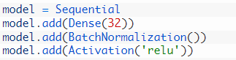
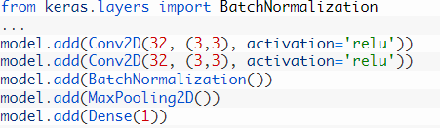
But deep learning libraries like keras provide with batch norm function
AI4LE Week 5. Session 1

Slide 31
What are the advantages of Batch Normalisation?
The model is less delicate to hyperparameter tuning.
Diminishes the reliance of gradients on the scale of the parameters or their underlying values
Weight initialization is a smidgen less significant at this point
Dropout can be evacuated for regularisation
AI4LE Week 5. Session 1

Slide 32
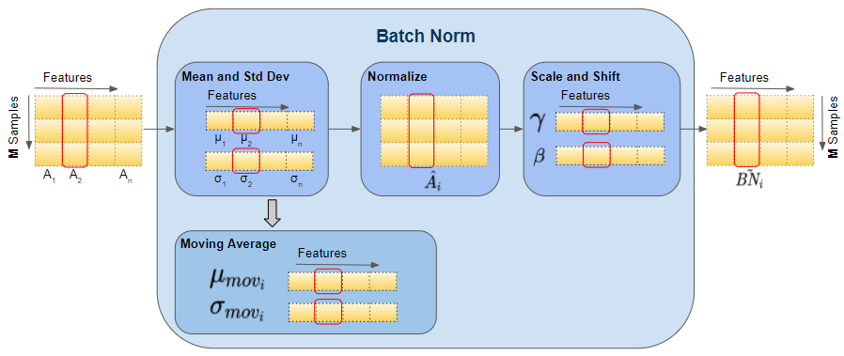
Batch normalization
AI4LE Week 5. Session 1

Slide 33
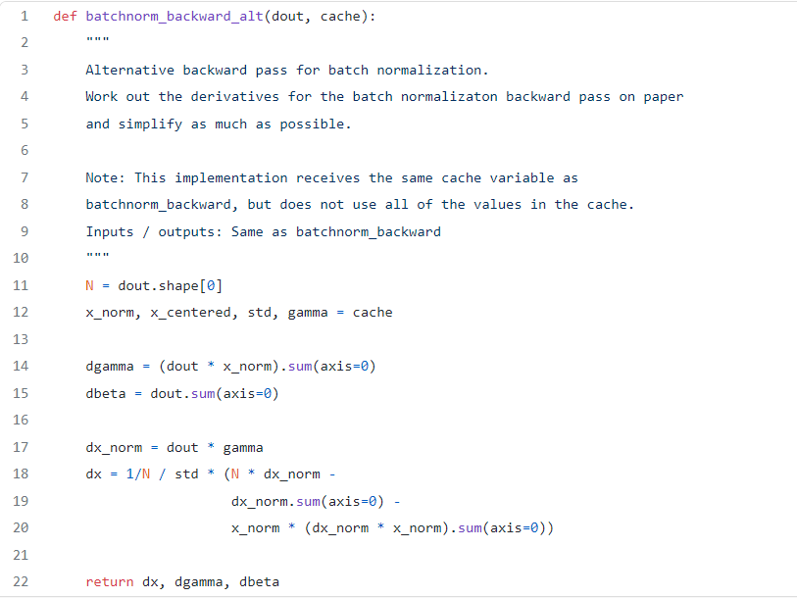
We can write batch norm code as
AI4LE Week 5. Session 1

Slide 34
Augmentation
CNN is not rotation and scale invariant
Eg we train our model on best pictures of flowers, roses, tulip and sunflower but if we test it over not so clear, properly scales, or rotated picture it may not be so accurate
This problem is handled by data augmentation
AI4LE Week 5. Session 1

Slide 35
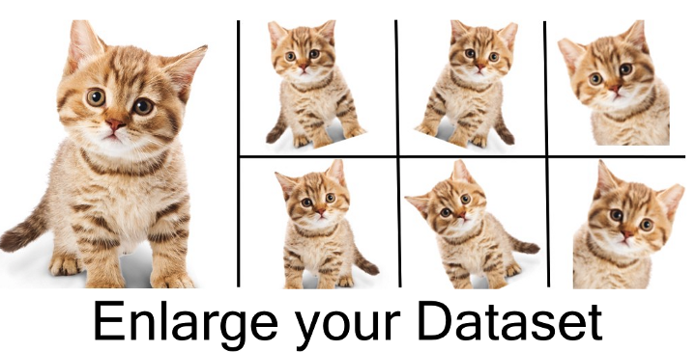
For example
We generate 4 samples by one and thus by doing so we make our model more robust and increase its efficiency
AI4LE Week 5. Session 1

Slide 36
How do we do it
Use the Keras preprocessing layers, such as tf.keras.layers.Resizing, tf.keras.layers.Rescaling, tf.keras.layers.RandomFlip, and tf.keras.layers.RandomRotation.
Use the tf.image methods, such as tf.image.flip_left_right, tf.image.rgb_to_grayscale, tf.image.adjust_brightness, tf.image.central_crop, and tf.image.stateless_random*.
AI4LE Week 5. Session 1

Slide 37
Example
resize_and_rescale = tf.keras.Sequential([
layers.Resizing(IMG_SIZE, IMG_SIZE),
layers.Rescaling(1./255)
])
AI4LE Week 5. Session 1

Slide 38
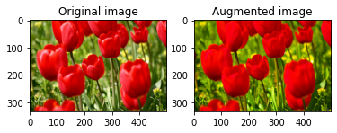
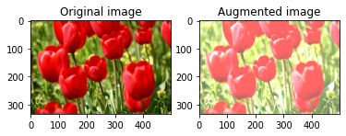
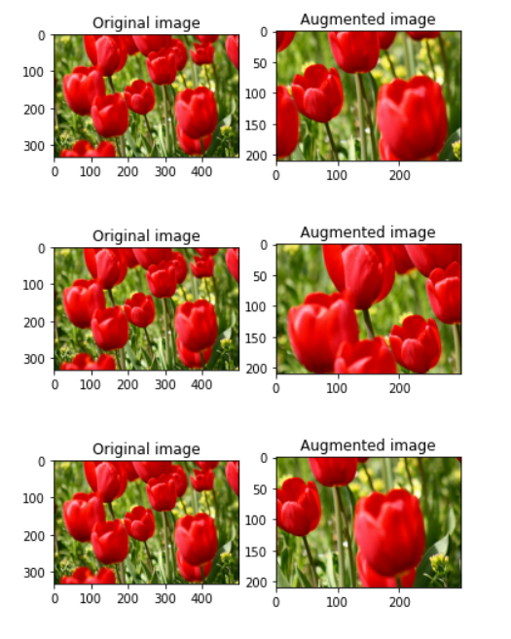
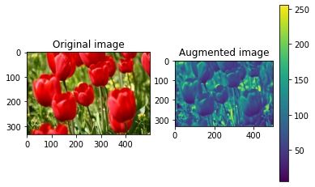
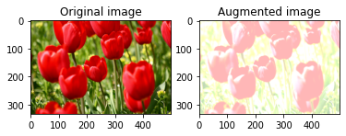
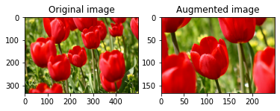
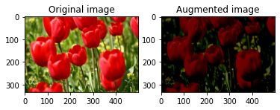
Example
AI4LE Week 5. Session 1

Slide 39
Time for some practice questions!
Q-1 What do you understand by receptive layer and what role it plays in Deep neural network?
Q-2 What is the exact problem of diminishing gradients? How can we solve it?
Q-3 What is Pooling? Write down the names for different pooling techniques.
Q-4 Explain in detail concept of Dropout and Batch normalization.
Q-5 How data augmentation solves the problem with uncleared images?

